Slide 1
A genome-wide in silico motif scan to identify functional clustering
Atreyi Chakraborty
Supervisor
Dr. M.S. Madhusudhan
Lab meeting: 22-08-23
Notes:
In humans, nearly two meters of genomic material must be folded to fit inside each micrometer-scale cell nucleus while remaining accessible for gene transcription, DNA replication, and DNA repair. The physical organization of chromosomes inside the nucleus is non random and occupies distinct territories . Important to know what keeps them there. This project builds on another work done in with my senior Sanjana Nair where we establish rules of specificity for DNA protein interactions.

Slide 2
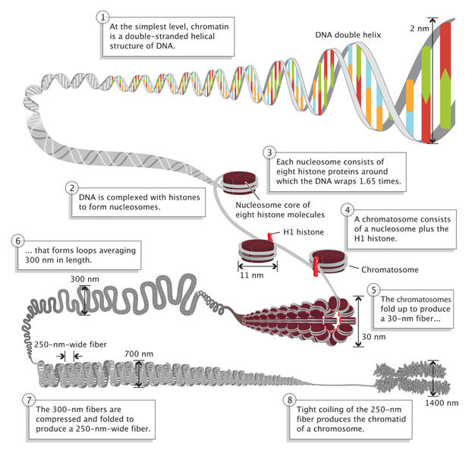
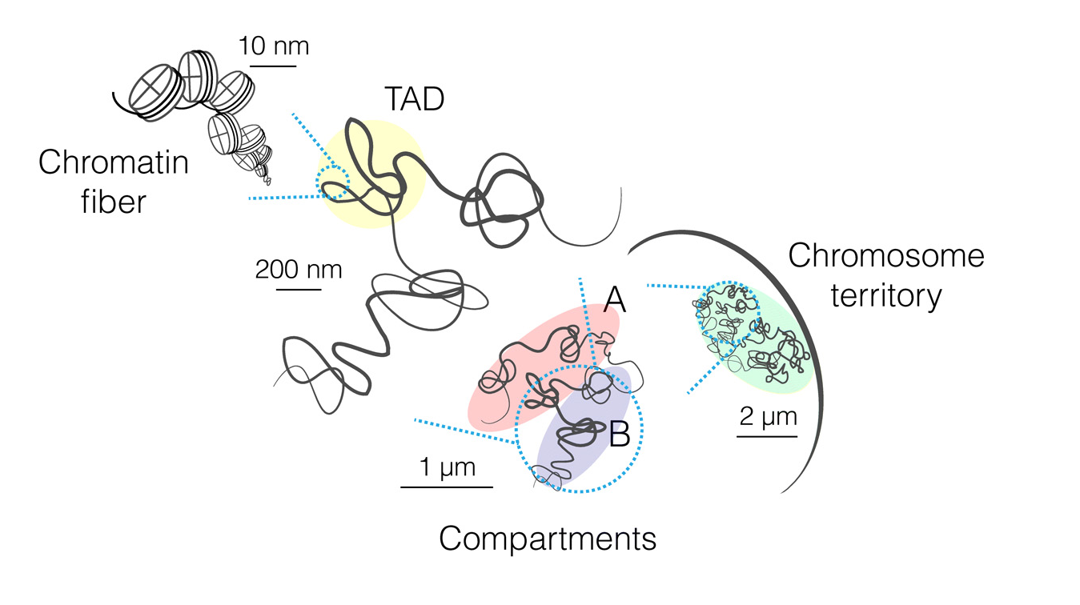
Introduction
Specific Aims
Methodology
Results
Future Work
Human Genome: Organization of 3.2 Billion bp
Pray, L. (2008) Eukaryotic genome complexity. Nature Education 1(1):96
Quentin Szabo et al.(2019) Principles of genome folding into topologically associating domains.Sci. Adv.5

Slide 3
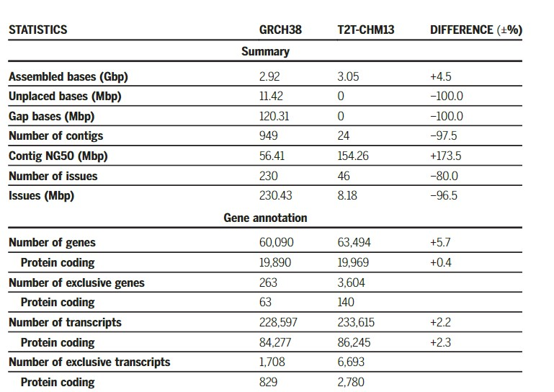

Introduction
Specific Aims
Methodology
Results
Future Work
Human Genome: Organization of 3.2 Billion bp
T2T-CHM13 now provides sequence information of the 151-Mbp that was unknown in GRCh38 reference assembly

Slide 4
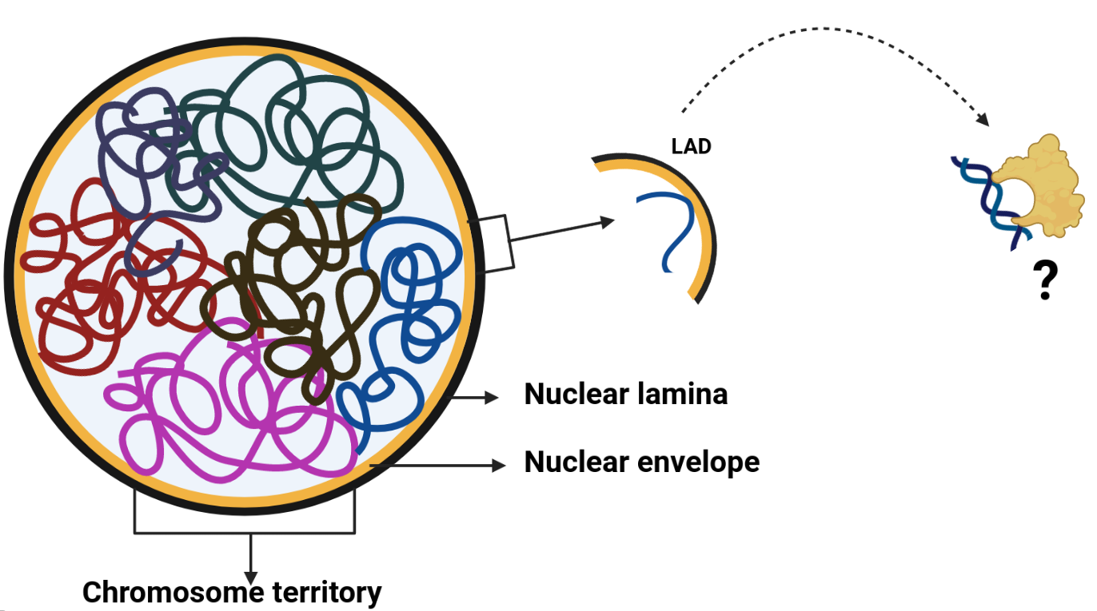
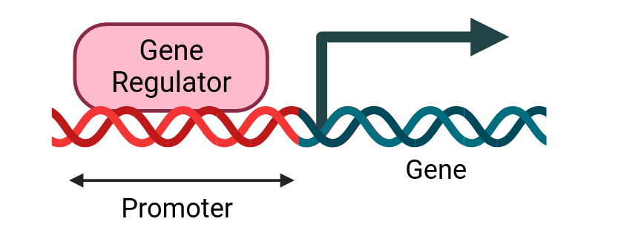
Introduction
Specific Aims
Methodology
Results
Future Work
Genome Sequence to Function
Motif distribution in genome
Gene regulation
Chromosome Positioning
Regulatory network prediction
Validation
Motif identification
Model for Prediction

Slide 5
Introduction
Specific Aims
Methodology
Results
Future Work
Genome Sequence to Function
Motif distribution in
genome
Gene regulation
Chromosome Positioning
Regulatory network prediction
Validation
Motif identification
Model for Prediction

Slide 6
Introduction
Specific Aims
Methodology
Results
Future Work
Genome Sequence Regulating Function
Motif generation and distribution-metric scoring :
Whole Genome
Randomized genome
Centromere
Comparison of distribution in gene promoter :
Validation:
Comparison of spatial distribution from HiC with our functional distribution
Identification of common transcription factors
Gene regulation by common transcription factors
1 kb, 2 kb and 6 kb upstream
Notes:
This brings to the three major aims of the project that is based on the hypothesis that there is active transport of the localization of the chromosomal segments by a single or multiple protein binding partners. Hence it is important to understand what constitutes the LAD iLAD regions.

Slide 7
Introduction
Specific Aims
Methodology
Results
Future Work
O/E : Motif distribution metric
Motif Scoring
AATTT - AAATT
Forward - Reverse
Genome Size: N Motif Size: n Kmer count: 4ⁿ
Base count: kₓ Base probability: f_{ₓ} (where X: A/T/G/C)
Observed Count: Total count in the genome
Expected Count: (f_{ₓ})^{kₓ} × (N-n +1)

Slide 8
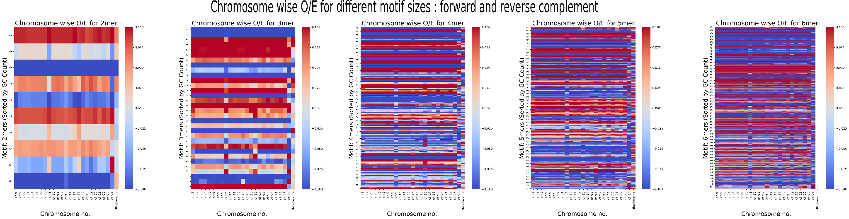
Introduction
Specific Aims
Methodology
Results
Future Work
Improved representation of distribution with increased motif size
6mer is the highest size considered as higher than 6mer exceeds sampling size of smaller genomes
DNA binding site in protein cannot accommodate more than 6mers

Slide 9
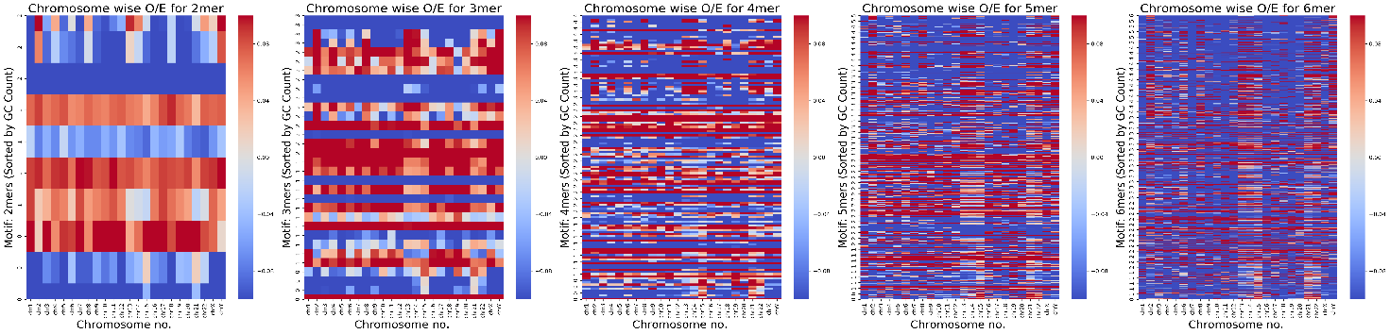
Introduction
Specific Aims
Methodology
Results
Future Work
Improved representation of distribution with increased motif size
Identification of acrocentric chromosomes: 13,14,15,21,22

Slide 10
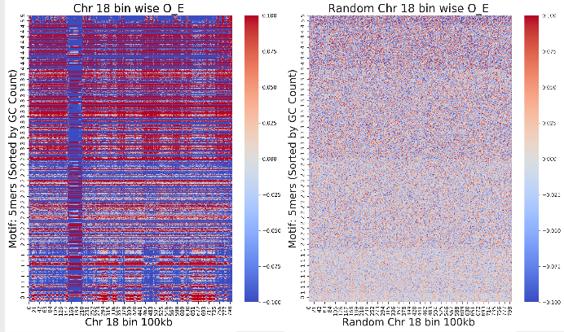
Introduction
Specific Aims
Methodology
Results
Future Work
Motif distribution is not randomized
5mer
The motif patterns are conserved in the actual chromosome sequence .
Work done by Sumant Chopde
Notes:
So we obtained which motifs have the maximum score in the LAD regions across all chromosomes . ie the have a higher count of LAD/iLAD . 10 (8mers) .

Slide 11
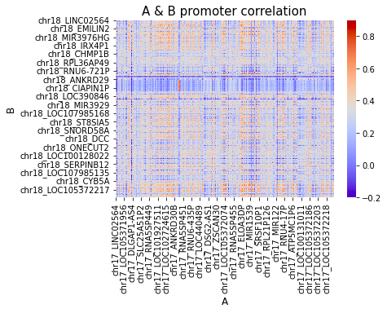
Introduction
Specific Aims
Methodology
Results
Future Work
Genome segment wise comparison
Promoter correlation
Motif Pair | Promoter_{i} | Promoter_{j}
Kmer₁ | P_{i1} | P_{j1}
Kmer₂ | P_{i2} | P_{j2}
Kmer₃ | P_{i3} | P_{j3}
….Kmer_{4ⁿ} | ……..P_{i4ⁿ} | ……..P_{j4ⁿ}
ρX,Y= covX,YX×σY where covX,Y= (X- μX)×(Y- μY)

Slide 12
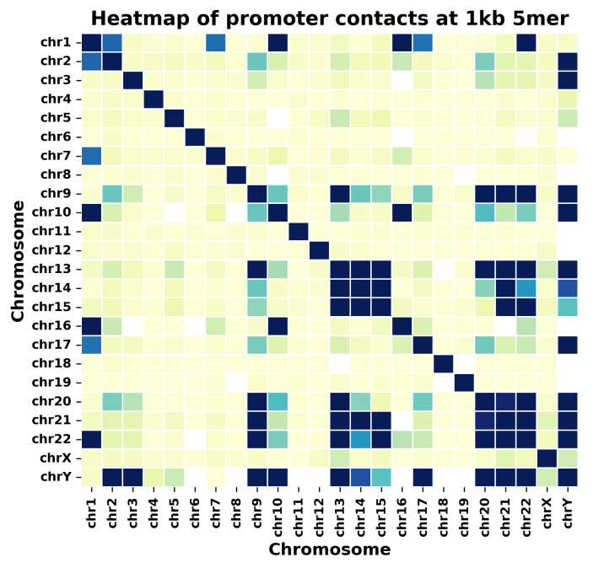
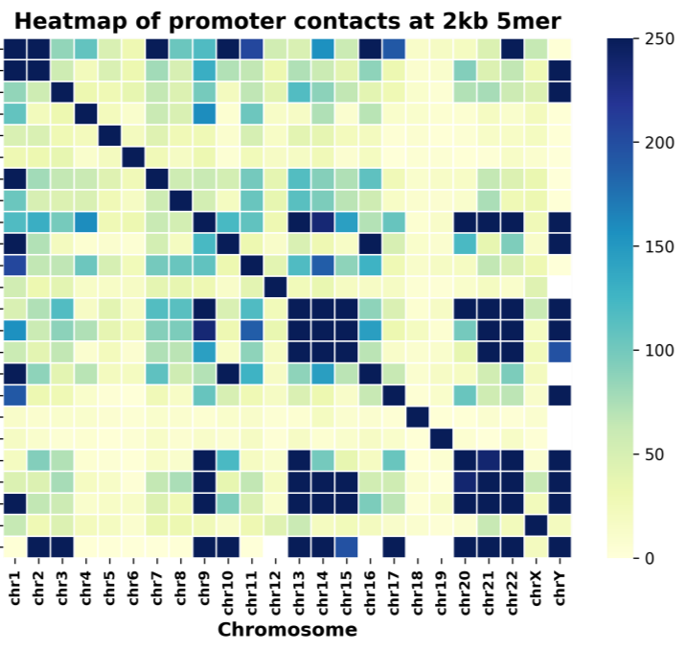
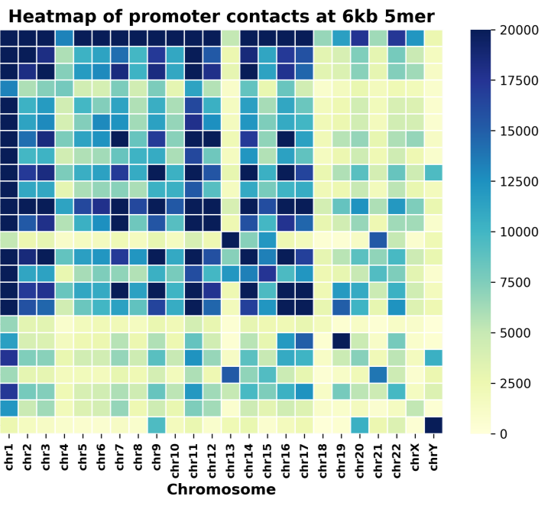
Introduction
Specific Aims
Methodology
Results
Future Work
Promoter with high correlation show a trend

Slide 13
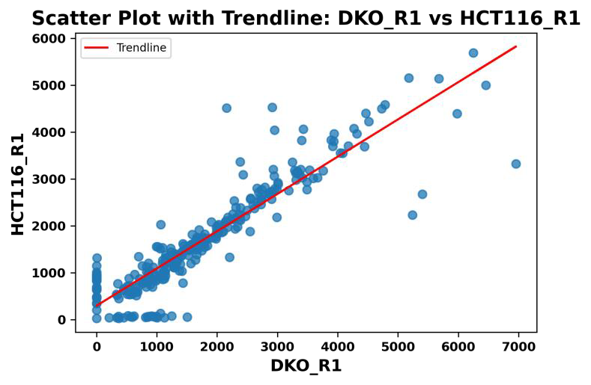
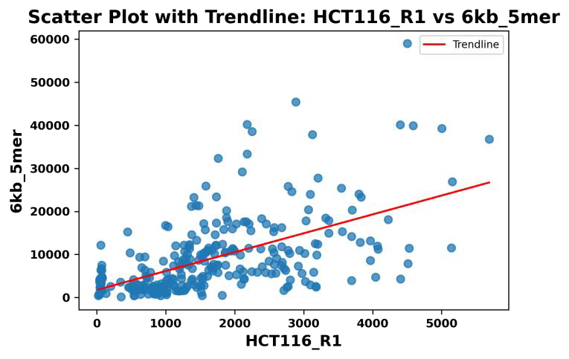
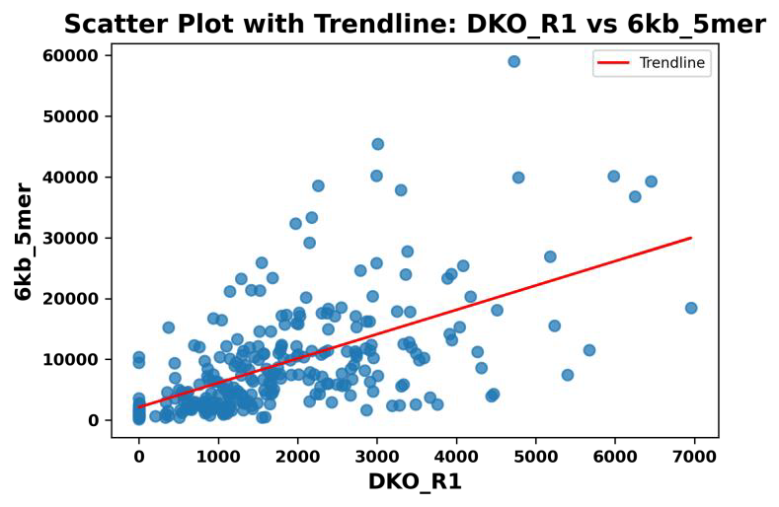
Introduction
Specific Aims
Methodology
Results
Future Work
Comparison with HiC data
Correlation | HCT116
Spearman Rank | 0.612
Pearson’s | 0.580
Correlation | DKO
Spearman Rank | 0.638
Pearson’s | 0.596
Spracklin, G., Abdennur, N., Imakaev, M. et al. (2023) Nat Struct Mol Biol .

Slide 14
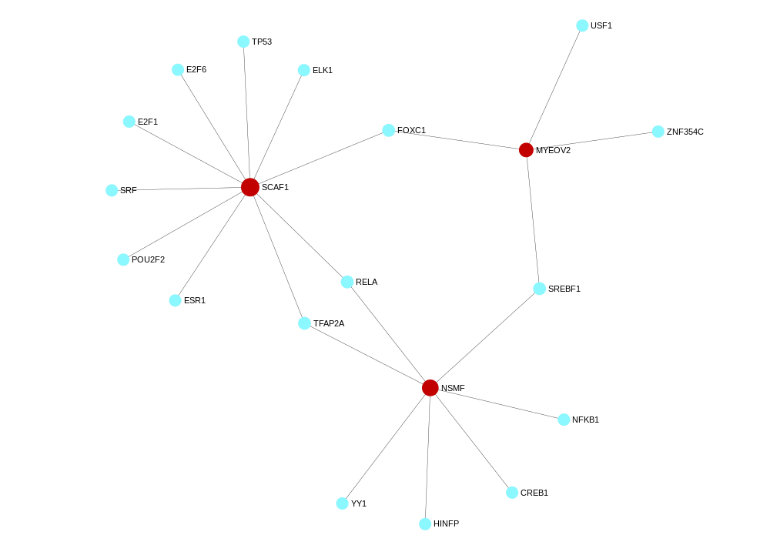
Introduction
Specific Aims
Methodology
Results
Future Work
Identification of common transcription factors
ChrA | ChrA gene | ChrB | ChrB gene | Corr
19 | SCAF1 | 9 | NSMF | 0.915
2 | COPS9 | 19 | SCAF1 | 0.582
2 | COPS9 | 9 | NSMF | 0.615
Zhou, Guangyan, et al"NetworkAnalyst 3.0: a visual analytics platform for comprehensive gene expression profiling and meta-analysis" (2019) Nucleic Acids Research

Slide 15
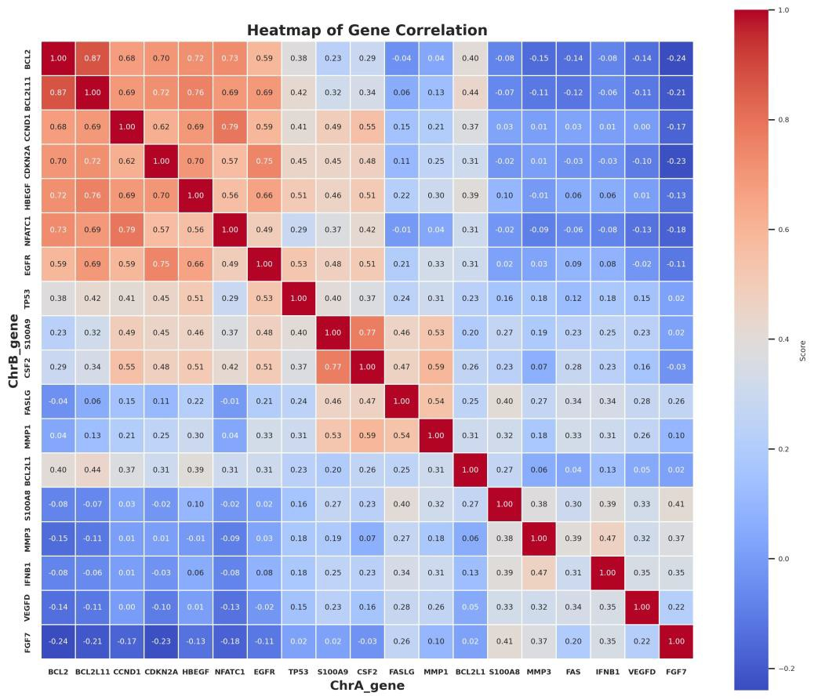
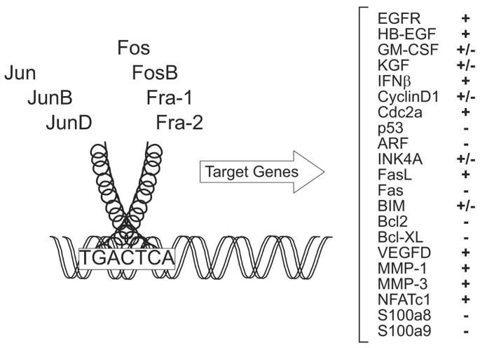
Introduction
Specific Aims
Methodology
Results
Future Work
Gene regulation by common transcription factors
Zenz, R., Eferl, R., Scheinecker, C. et al. Activator protein 1 (Fos/Jun) functions in inflammatory bone and skin disease. (2008) Arthritis Res Ther

Slide 16
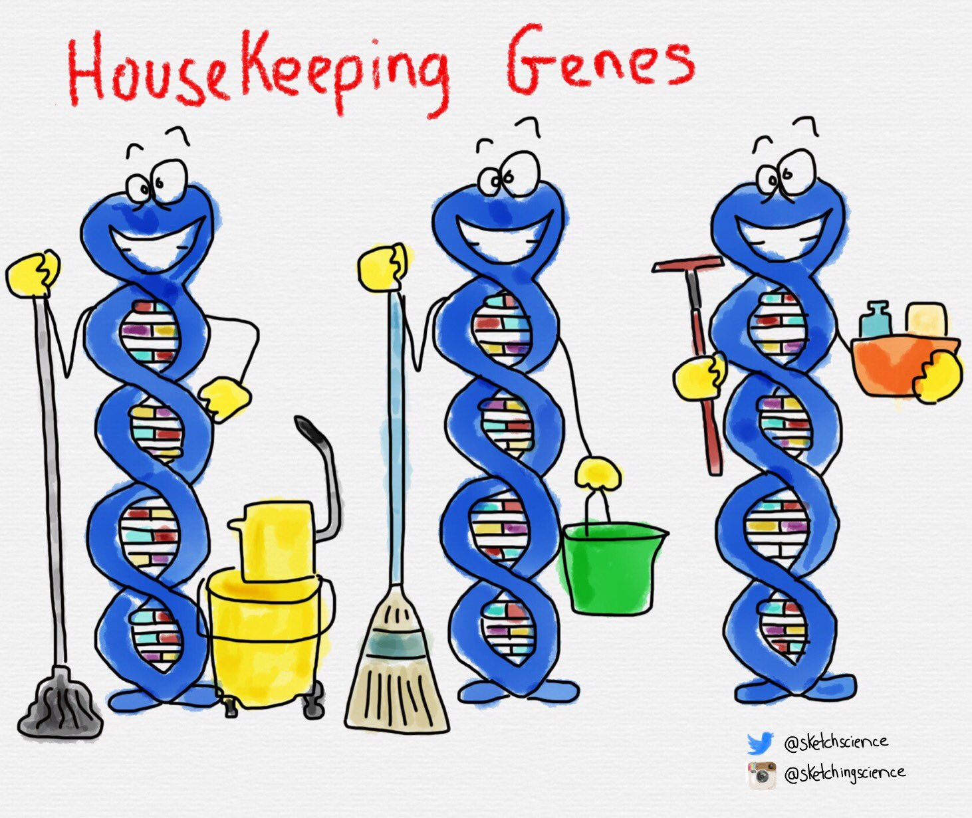
Introduction
Specific Aims
Methodology
Results
Future Work
Future Work
Housekeeping genes
Housekeeping genes have been defined as genes that are consistently expressed across tissues, essential, carrying out cellular maintenance, and conserved across species.
Work in progress by Daksh
Eisenberg, Eli, and Erez Y. Levanon.(2013) TRENDS in Genetics
Notes:
Housekeeping genes are involved in basic cell maintenance and, therefore, are expected to maintain constant expression levels in all cells and conditions. Identification of these genes facilitates exposure of the underlying cellular infrastructure and increases understanding of various structural genomic features.

Slide 17
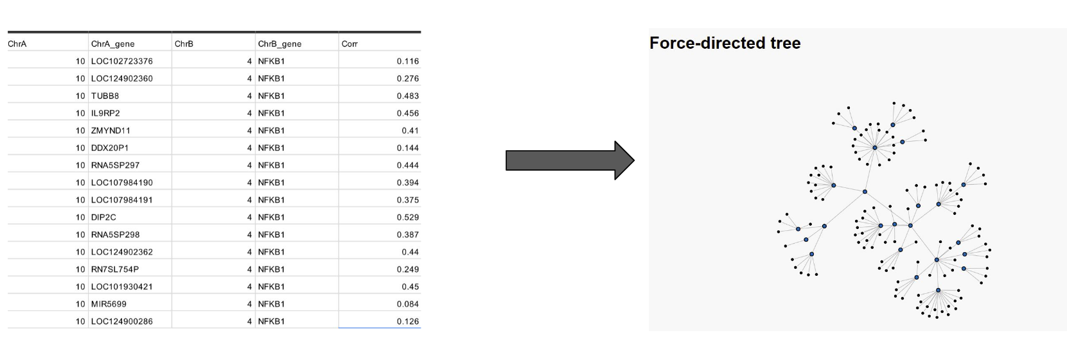
Introduction
Specific Aims
Methodology
Results
Future Work
Future Work
2. Gene regulatory network
Network will include GO terms:
Molecular function
Biological process
Cellular component
Work in progress by Ajinkya & Saksham
3. Shortlist gene candidates for experimental validation: In collaboration with Dr. Kundan Sengupta
Notes:
Housekeeping genes are involved in basic cell maintenance and, therefore, are expected to maintain constant expression levels in all cells and conditions. Identification of these genes facilitates exposure of the underlying cellular infrastructure and increases understanding of various structural genomic features.

Slide 18


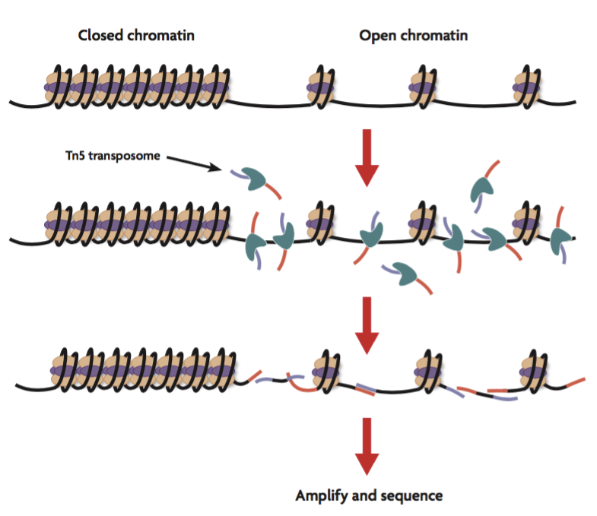
Introduction
Specific Aims
Methodology
Results
Future Work
Future Work
4. Genome sequencing data: HiC , ATAC Seq etc
Motif correlation
Hi-C measures the frequency at which two DNA fragments physically associate in 3D space, linking chromosomal structure directly to the genomic sequence.
Bin 1
Bin 2
The assay for transposase-accessible chromatin with sequencing (ATAC-Seq) : is a popular method for determining chromatin accessibility across the genome.
Work in progress by Siddharth
https://sapac.illumina.com/techniques/sequencing/dna-sequencing/l
Notes:
By sequencing regions of open chromatin, ATAC-Seq can help you uncover how chromatin packaging and other factors affect gene expression

Slide 19



Introduction
Specific Aims
Methodology
Results
Future Work
Future Work
5. Comparison across genome
Motif correlation
Species 1
Species 2
Notes:
By sequencing regions of open chromatin, ATAC-Seq can help you uncover how chromatin packaging and other factors affect gene expression

Slide 20
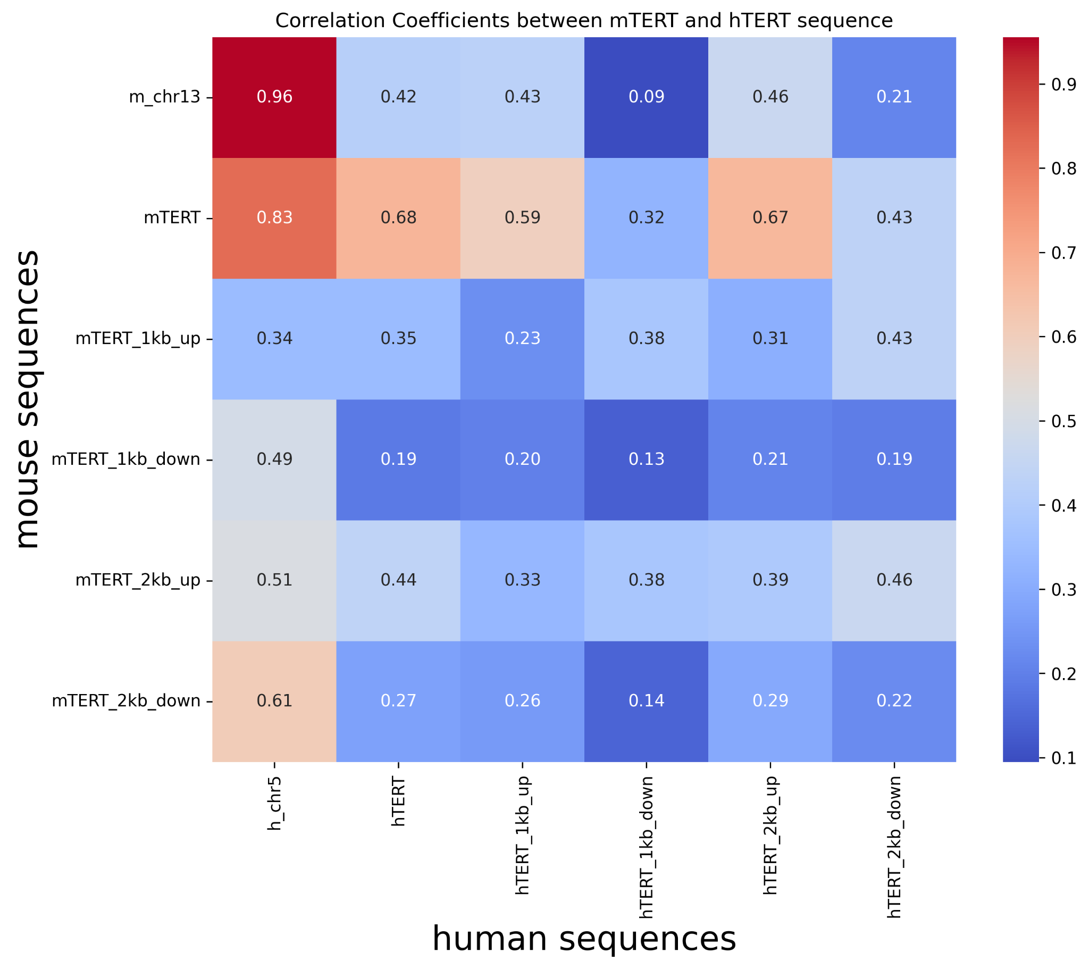
Introduction
Specific Aims
Methodology
Results
Future Work
Future Work
5. Comparison across genome
Motif correlation
Species 1
Species 2
Telomeres are 5 to 10 times shorter than in mice
Telomerase activity varies between species and is regulated by the TERT gene.
Differential regulation of TERT expression between mice and humans is influenced by specific genetic elements.
In collaboration with Prof.Vinay Telgaonkar
Horikawa, Izumi, et al.(2005) PNAS
Notes:
Telomerase is an enzyme that plays a crucial role in maintaining the length of telomeres, the protective caps at the ends of chromosomes. Telomerase activity varies between species and is regulated by the TERT gene.
In this study, researchers investigated the differences in telomerase activity expression between mice and humans. Telomerase is an enzyme that plays a crucial role in maintaining the length of telomeres, the protective caps at the ends of chromosomes. Telomerase activity varies between species and is regulated by the TERT gene.
To better understand this regulation, the researchers created transgenic mice carrying both mouse and human TERT genes, each controlled by their own regulatory sequences. The goal was to study how these genes are regulated in the same cellular context in vivo. They utilized a cloning technique called transformation-associated recombination (TAR) cloning, which allowed them to isolate and maintain large genomic regions containing the TERT genes.
The study revealed that the differential regulation of TERT expression between mice and humans is influenced by specific genetic elements. For instance, they identified a human-specific GC-box, a DNA sequence that plays a role in gene expression regulation, which contributes to the repression of TERT transcription in humans. When this human-specific GC-box was introduced into the mouse TERT promoter, it led to similar repression of transcription as seen in humans.
The researchers also found that the tissue-specific expression patterns of TERT were largely maintained in the transgenic mice, except for the brain, suggesting that there might be unique regulatory mechanisms for TERT expression in brain cells.
Moreover, the study highlighted the importance of understanding these regulatory mechanisms for both aging and cancer research. Differences in telomere length and telomerase activity are associated with aging and cancer development. By deciphering the genetic elements that govern TERT expression, researchers can create more accurate animal models for studying human-specific processes like aging and carcinogenesis.
In conclusion, this study provided valuable insights into the species-specific and tissue-specific regulation of telomerase activity, shedding light on the mechanisms that contribute to the differences in telomere biology between mice and humans. The findings have implications for understanding aging, cancer, and other cellular processes influenced by telomerase and telomeres.
the researchers created transgenic mice carrying both mouse and human TERT genes, each controlled by their own regulatory sequences
The study revealed that the differential regulation of TERT expression between mice and humans is influenced by specific genetic elements. For instance, they identified a human-specific GC-box, a DNA sequence that plays a role in gene expression regulation, which contributes to the repression of TERT transcription in humans. When this human-specific GC-box was introduced into the mouse TERT promoter, it led to similar repression of transcription as seen in humans.

